Slide 1

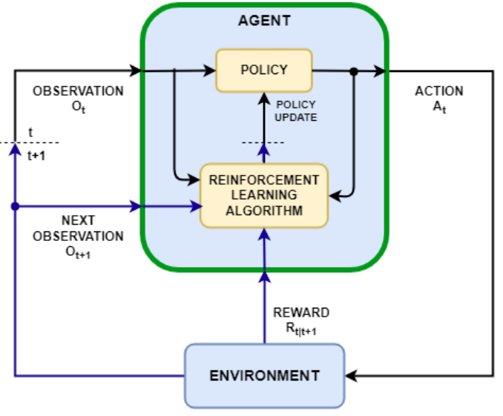
Reinforcement Learning
Applications of RL
Markov Decision Process (MDP)
The Bellman Equation
Q-Networks
Policy Gradients
Proximal Policy Optimization (Train LLM)
Dr Azhar Mahmood
Office: EB.1.85 Email: a.mahmood3@uel.ac.uk

Slide 2
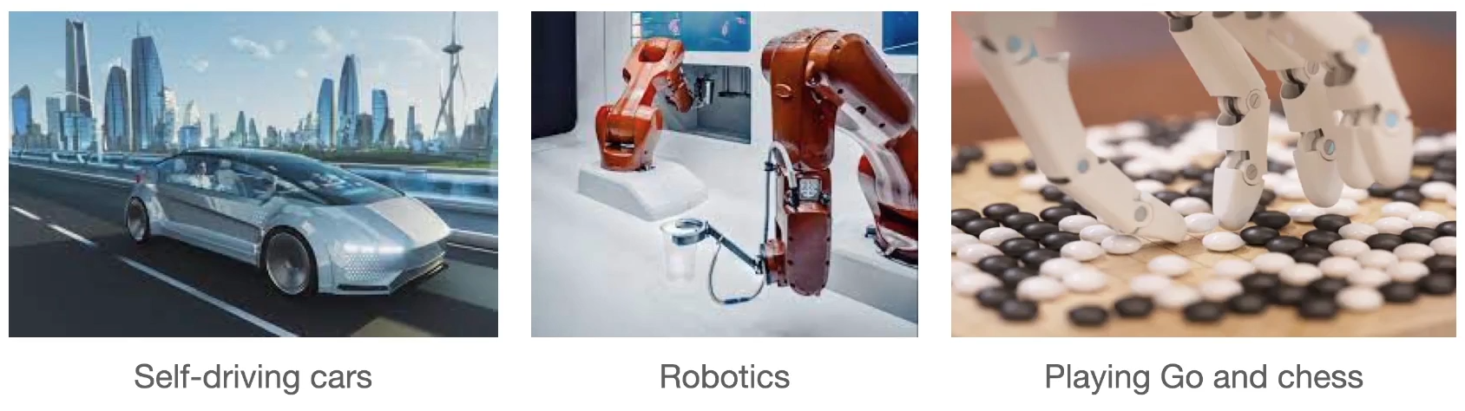
Application of Reinforcement Learning

Slide 3
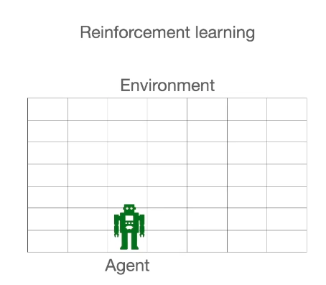
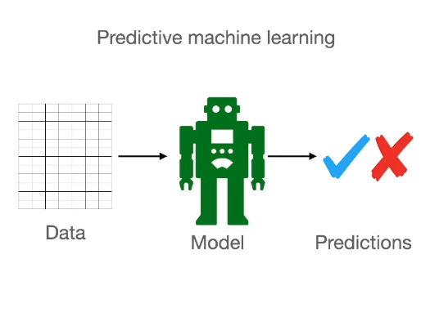
Different from the rest of ML

Slide 4
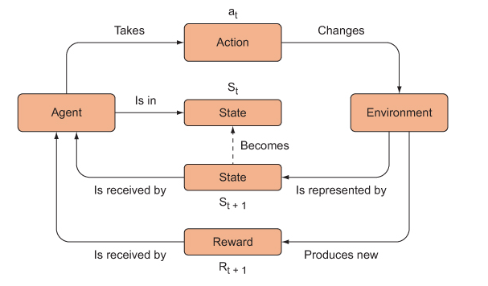
Reinforcement Learning

Slide 5
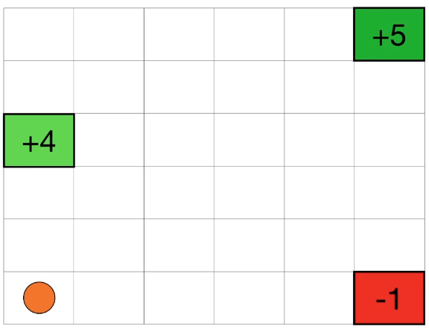

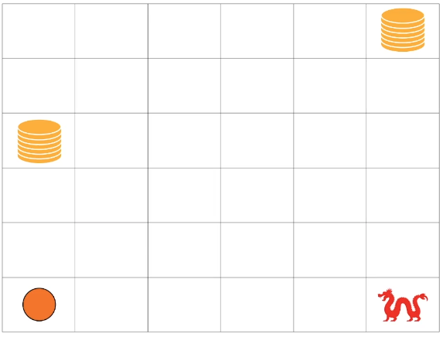
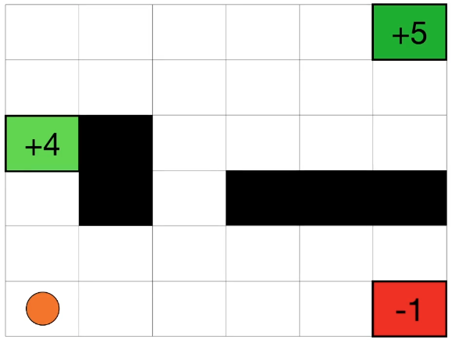
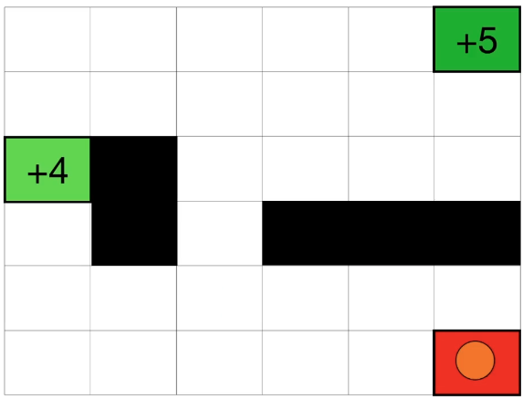
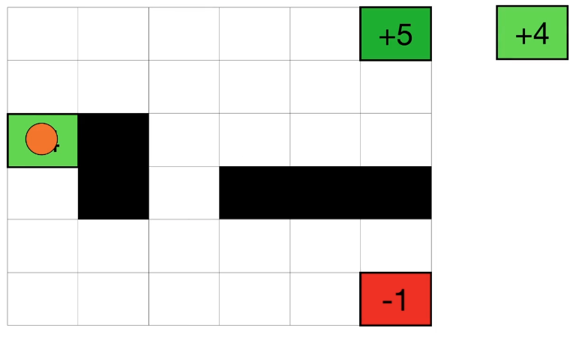
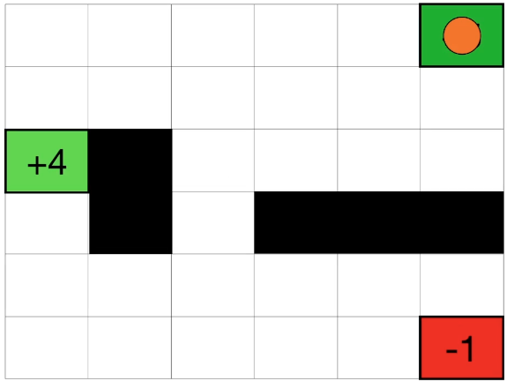


Markov Decision Process (MDP)
Notes:
Markov decision process (MDP), also called a stochastic dynamic program or stochastic control problem, is a model for sequential decision making when outcomes are uncertain.
Pole Balancing example (rendering of the environment from the Open AI gym benchmark)

Slide 6
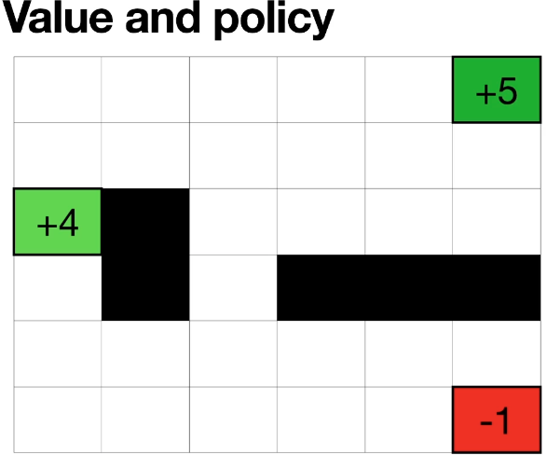
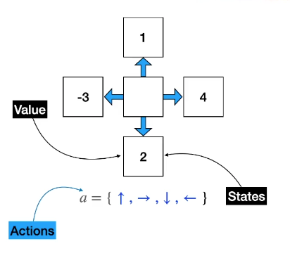
Markov Decision Process (MDP)
Values, States, Actions and Policy

Slide 7
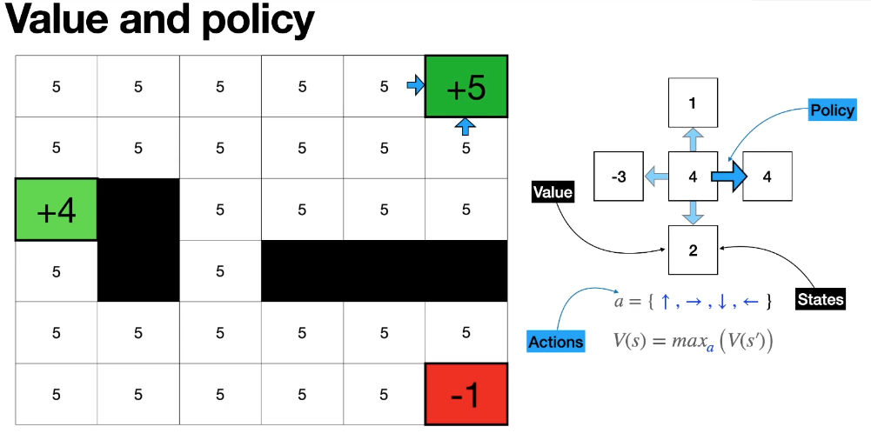
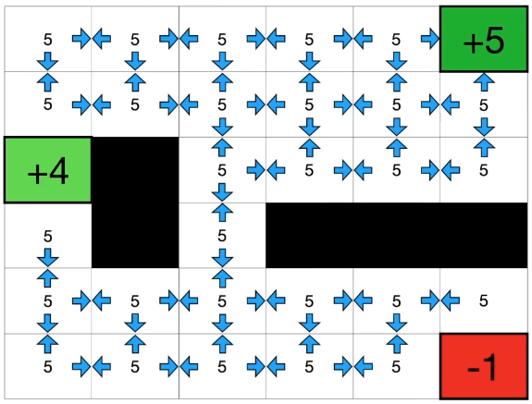
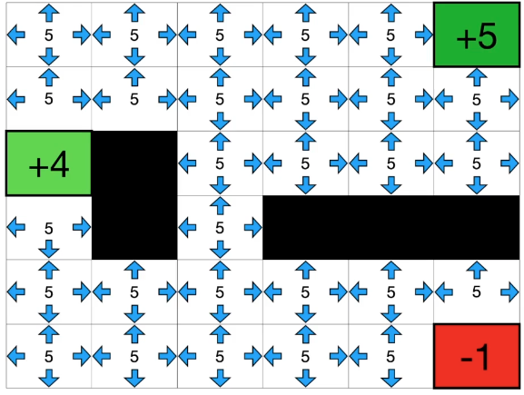
Markov Decision Process (MDP)
Values, States, Actions and Policy

Slide 8
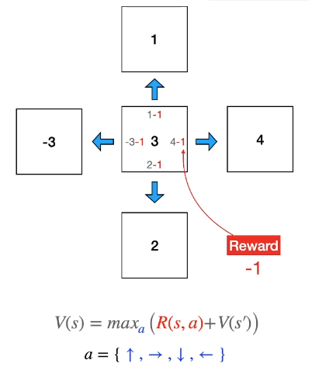
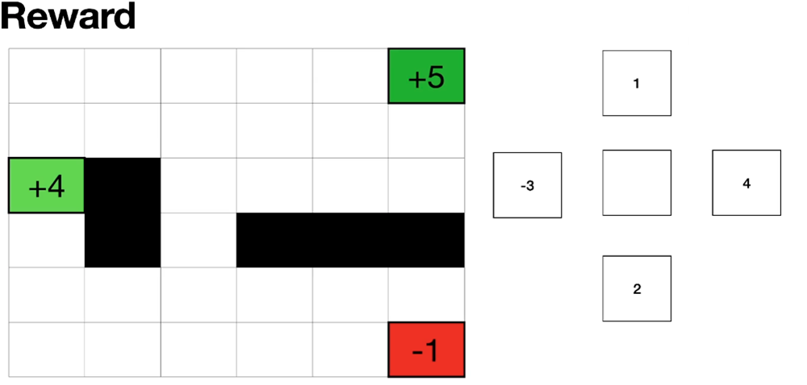
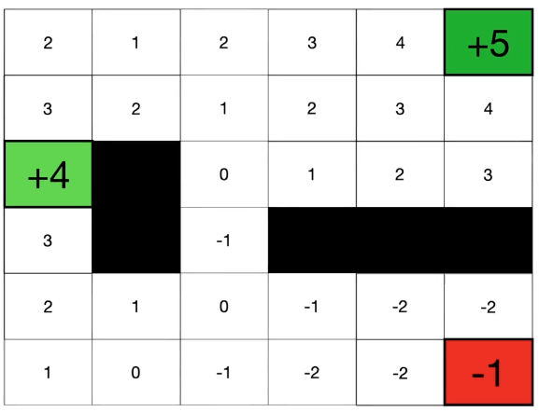
Markov Decision Process (MDP)

Slide 9
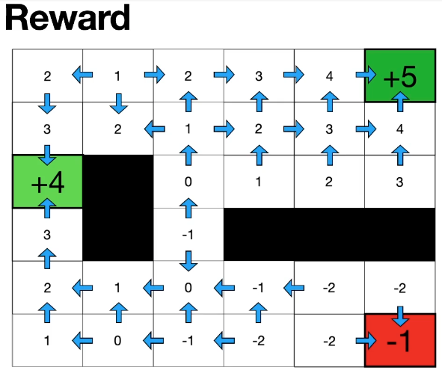
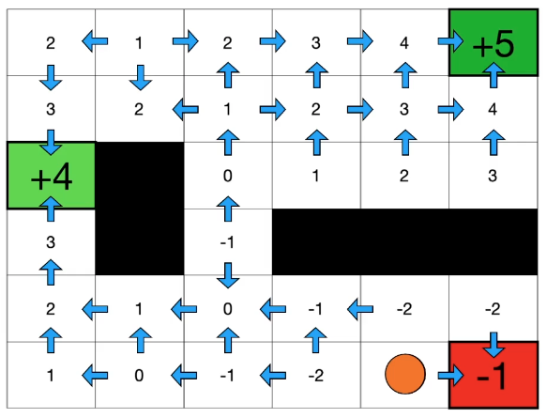
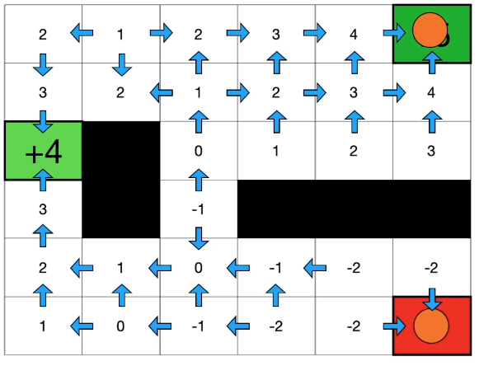
Markov Decision Process (MDP)
Extra cost to reach here
Notes:
Example of Nearby Restaurant(more cost) and Food at home(Less cost)

Slide 10
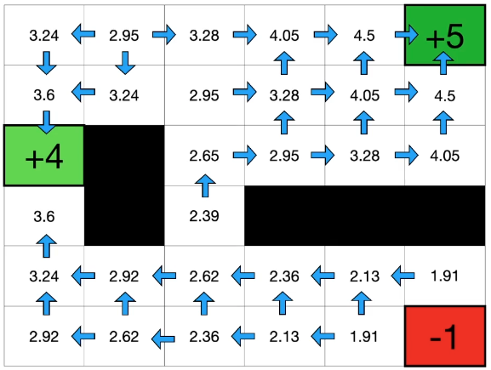
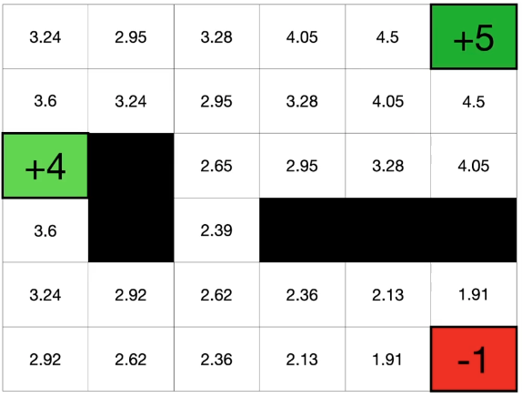
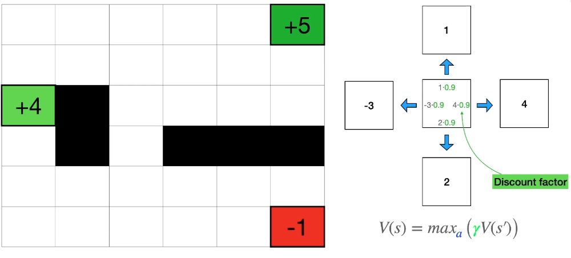
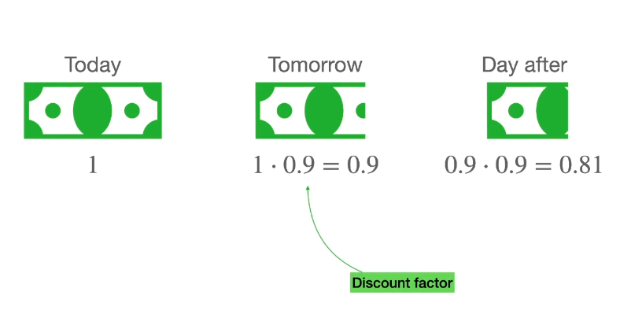
Markov Decision Process (MDP)
Discount Factor

Slide 11


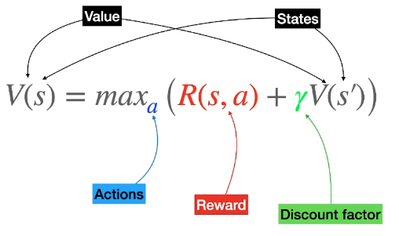
The Bellman Equation
Every time when we take a Step may lose 1 point , and another one have discount factor which multiply it by 0.9

Slide 12
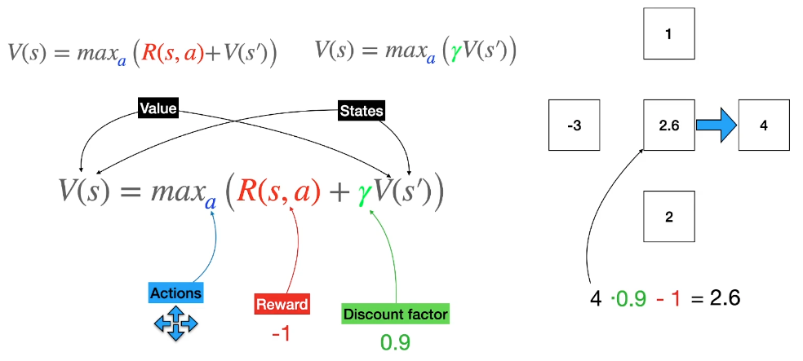
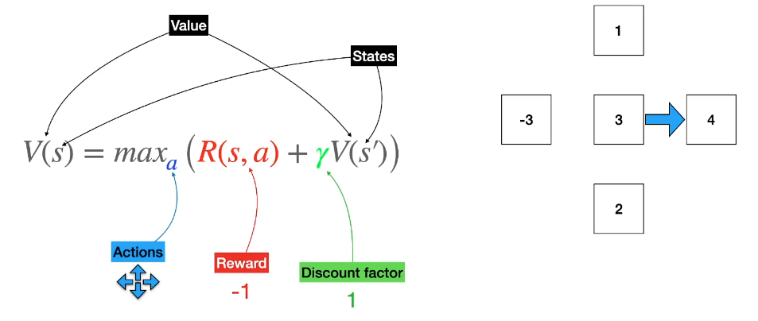
The Bellman Equation

Slide 13
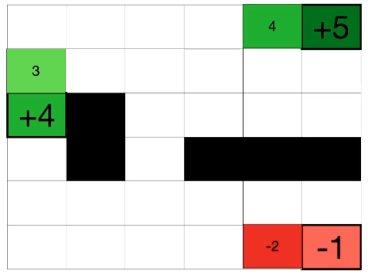
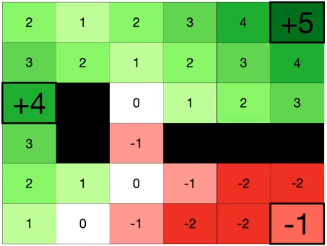
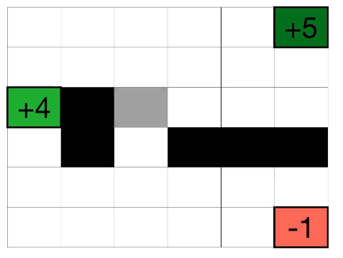
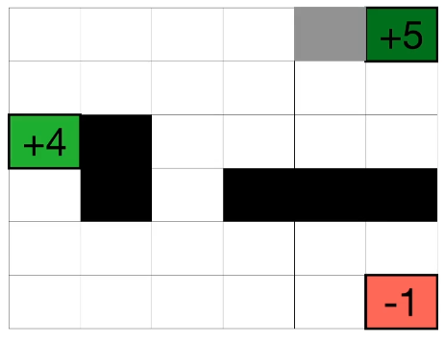
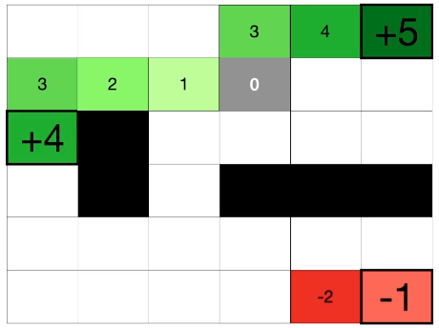
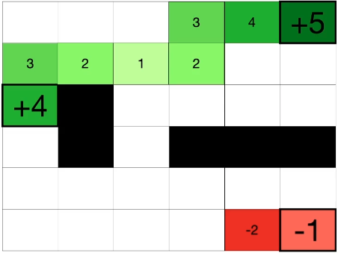
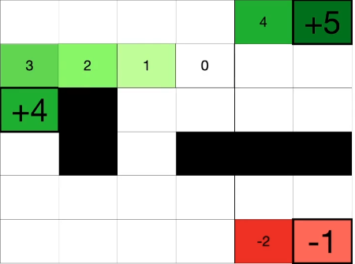
How to solve the Bellman Equation
Policy: At every point you draw an arrow towards the highest value around you.

Slide 14
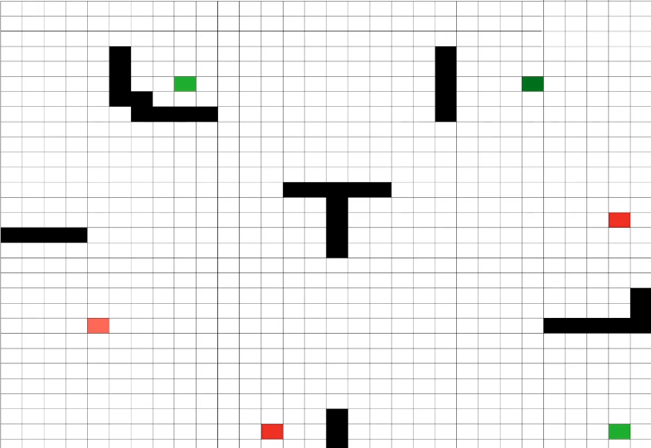
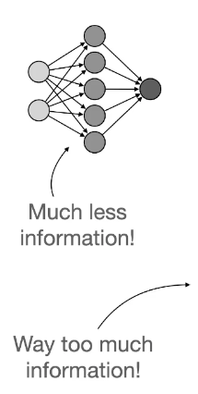
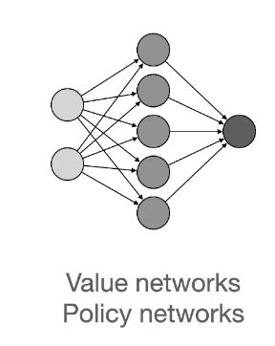
Neural Networks

Slide 15
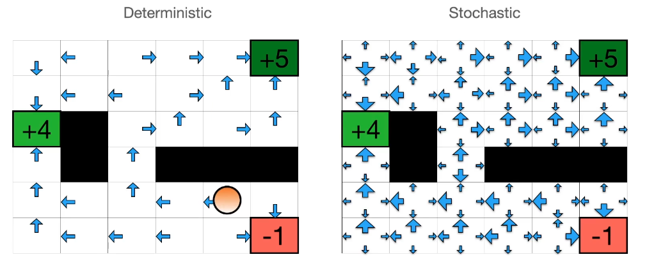
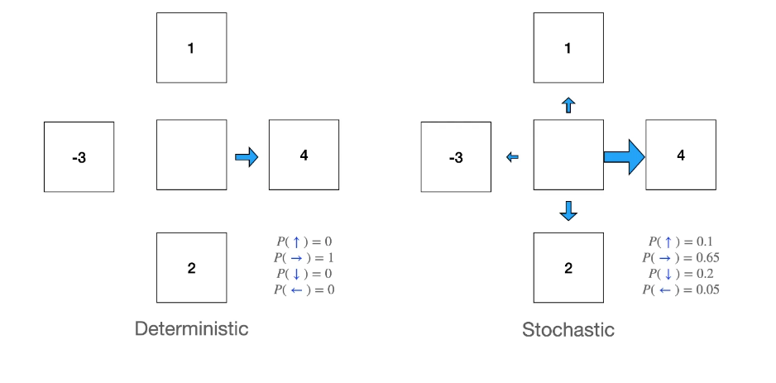
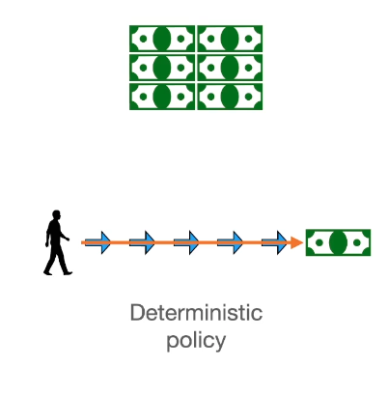
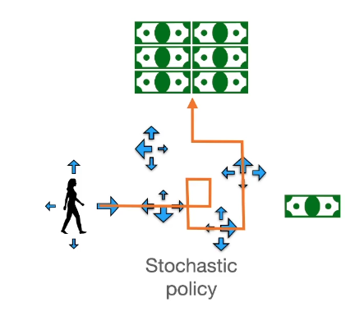
Deterministic and Stochastic Policies
Notes:
Deterministic models provide a clear cause-and-effect relationship between inputs and outputs, making them easier to interpret. However, they have limitations in capturing uncertainty and randomness. Stochastic models, conversely, consider uncertainty and provide a range of possible outcomes.

Slide 16
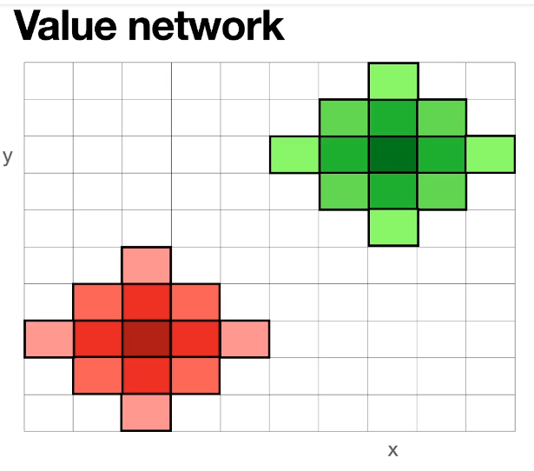
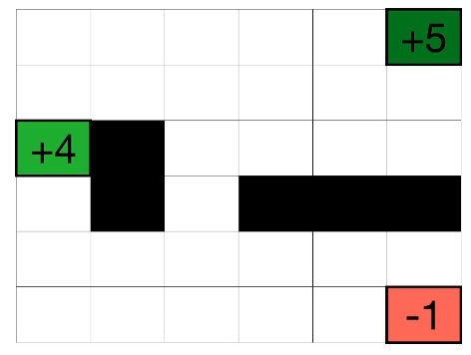
Why Neural Networks
Not possible to visit each box(state)

Slide 17
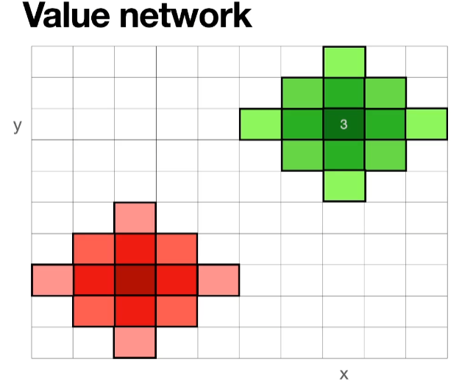
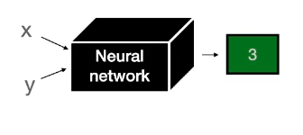
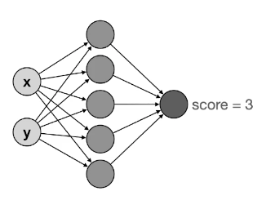
Why Neural Networks?
Guess the value of every point

Slide 18
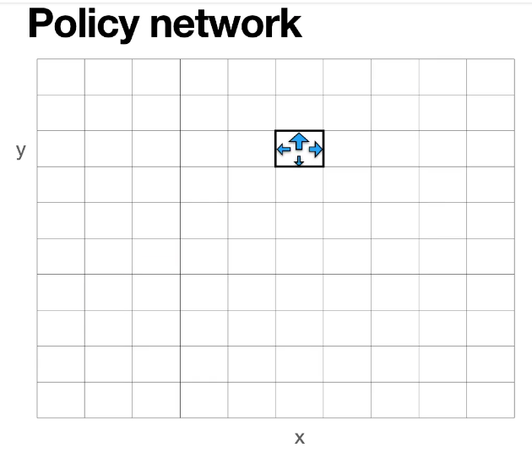
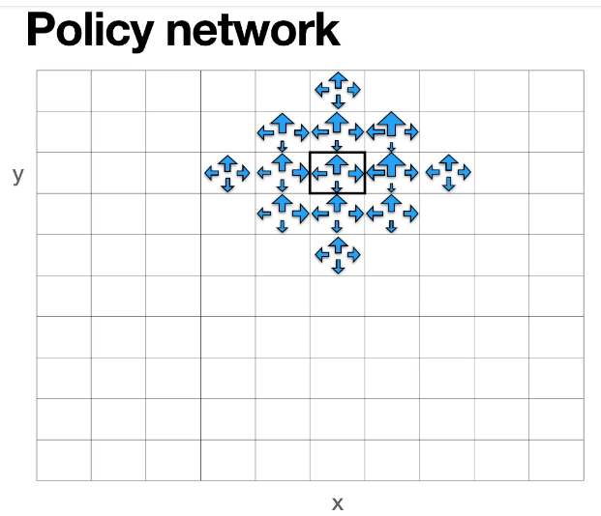


Why Neural Networks?
Guess the probability of going each of four directions
P(up)
P(down)
P(left)
P(right)

Slide 19

How to Train Value and Policy Network

Slide 20







Value Neural Network
Notes:
Keep Applying and feeding your value network with the help of your error function many times you get values like 0.45..and so on

Slide 21





Slide 22






Probability

Slide 23


Slide 24


Notes:
The learning rate (LR) determines how far the neural network weights change within the context of optimization while minimizing the loss function.

Slide 25

Training of Policy Network

Slide 26




State-action-reward-state-action (SARSA) is an on-policy reinforcement learning algorithm
Notes:
State–action–reward–state–action
SARSA updates action values based on the current policy being followed, while Q-Learning updates values of the optimal policy by maximizing over next actions.

Slide 27
Thanks!!!
Reach out with any questions on MSTeams
Email a.mahmood3@uel.ac.uk

